Slide 1
GETTING YOUR FIRST JOB: WHAT YOU NEED TO KNOW
Suraj Oyewale, ACA, ACIT
Founder, JarusHub Career Portal (www.jarushub.com)
Accountant @ an Oil & Gas Company
Presented @ the
UNIVERSITY OF IBADAN MUSLIM STUDENTS FINAL YEAR STUDENTS PROGRAMME
06.09.2015

Slide 2
Outline
When do you start?
What do you do?
Things to know
Acing job tests
Acing interviews

Slide 3
When do you start?
As early as secondary school (make good grades). Your WAEC result may make a different in job hunt. But it’s never too late.

Slide 4
When do you start?
SECONDARY SCHOOL
Know your strength
Avoid peer influence
Choose your course wisely

Slide 5
What to do…
At the University
Target good grade
Develop your communication skills
Engage in voluntary activities
Read profiles of successful people in your profession
Be versatile
Read relevant websites and journals
Build contacts
Enrol for relevant professional exams

Slide 6
What to do…
Before or During NYSC
Start practicing job tests
Draw up your CV and circulate
Subscribe to and read relevant career websites (JarusHub, The Muse, Glassdoor blog etc)
Start professional exams
Surf job sites
Network

Slide 7
What to do…
CONTENT OF A GRADUATE CV
Name, address, phone, email
Personal Information
Education & Qualifications
Work experience (if any)
Leadership activities
Awards, Honours & Recognitions (if any) Professional Association membership
Written works & project

Slide 8
What to do…
After NYSC
Circulate your CV
Move to city, especially Lagos
Cold emailing
Never underestimate any job

Slide 9
Things to know…
CAN YOU GET A JOB WITHOUT CONNECTION?
Yes, this is exaggerated
MY EDUCATED PROBABILITY
Public sector – 50%
International Oil Companies – 90%
Other MNCs – 80%
Banks – 70%
Nigerian big private companies – 50-70%

Slide 10
Things to know…
NETWORKING
Use of contacts to benefit
Networking vs whom-you-know
Acceptable all over the world
Maintain and oil relationships
Send your CVs to friends and other people in your network
Not all job info are advertised
Networking aids the prepared
It’s just a bonus, doesn’t stop you from getting job

Slide 11
Things to know…
FIRST CLASS IS NOT AUTOMATIC EMPLOYMENT
You need to hustle
It at best gets you invite for test
Can be a plus or minus for you…but always a plus for anyone that can defend it

Slide 12
Things to know…
WHAT POOR-GRADERS CAN DO
Get special skills
Get special qualifications
Consider Masters
Target public sector
Never look down any experience

Slide 13
WHEN IS TOO LONG TO START GETTING WORRIED?
Not getting job 6 months after NYSC is still not a bad situation yet. But use the period purposefully, try learning other skills or trade.

Slide 14
ACING JOB TESTS…
Research about format
Practice
Time yourself
Work on your weaknesses

Slide 15
ACING INTERVIEWS…
Prepare well
Talk to someone that had done it
Rehearse
Read interview materials
Versatility helps

Slide 16
ACING TESTS & INTERVIEWS…
TOOLS TO RESEARCH A COMPANY
Google
Nairaland
JarusHub
Facebook
LinkedIn
Friends & family

Slide 17
ANSWERING COMMON INTERVIEW QUESTIONS…
Tell me about yourself
What do you know about our company?
Why do you want to work for us?
What are your strengths? Weaknesses?
What are your selling points? Your core competences?

Slide 18
Ultimately…
“ What will hit you will not miss you, and what will miss you will not hit you…but tie your camel”
Never compromise your deen!!!

Slide 19
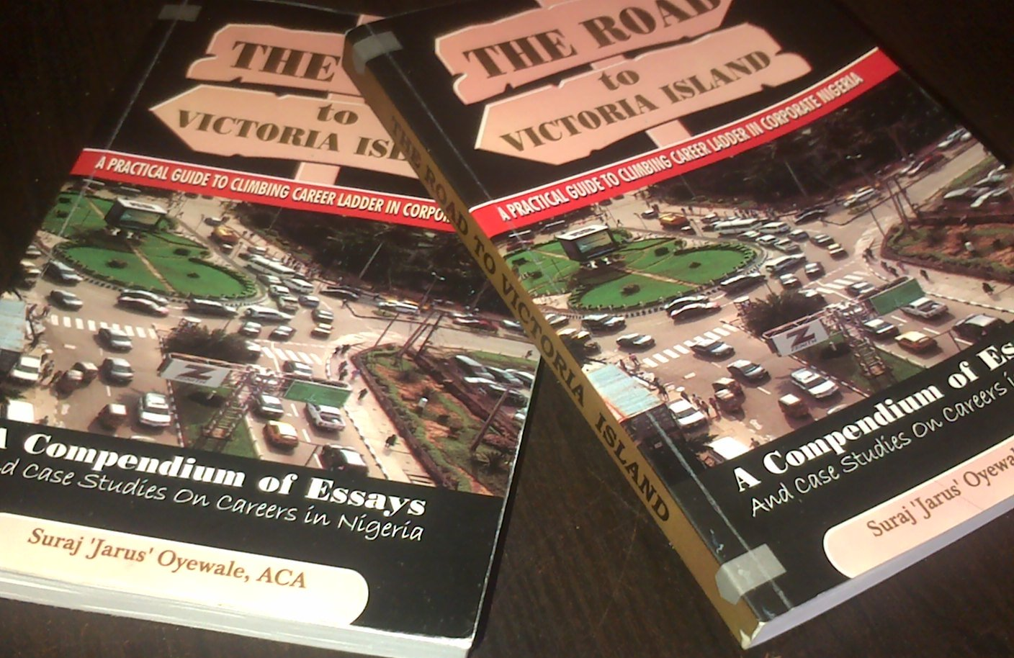
FURTHER READING: THE ROAD TO VICTORIA ISLAND: A PRACTICAL GUIDE TO CLIMBING CAREER LADDER IN CORPORATE NIGERIA (Suraj Oyewale, ACA, June 2014) sms 08061198625 to order

Slide 20
THANKS FOR LISTENING
THANKS FOR LISTENING

