Slide 1
CHOOSING A CAREER IN SOCIAL SCIENCES/ACCOUNTING: What you need to know
Suraj Oyewale, Bsc (Econs), ACA
Founder, Jarushub.com

Slide 2

When to Choose?
Primary School
Secondary School
Post-secondary school
Post-graduation

Slide 3
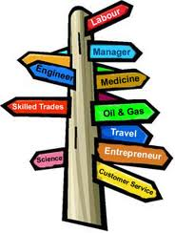
What to choose?
Passion
Parental guidance
People around
Self-decision
Accidental

Slide 4

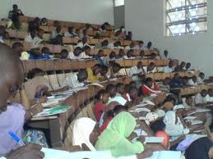
Factors in Academic Success
Start early
Right course
Optimistic mindset
Mentorship
Set a target
Compete
Know yourself
Know your teachers
Pray

Slide 5

Other factors: Beyond academics
Be versatile
Network
Engage in extra-curricular activities
Packaging

Slide 6

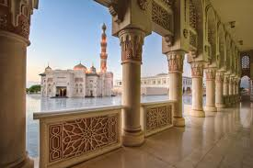
Islam and Your Academics
Never hide your Islamic identity
Engage in mosque activities
Attend MSSN tutorials
Never abandon your salats for anything
Strike a balance

Slide 7
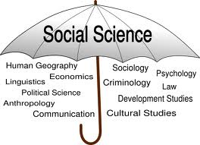
Social Sciences/Administration
CONSTITUENTS:
Economics
Geography
Sociology
Psychology
Business Administration
Demography
Political Science
etc

Slide 8
Social Sciences/Admin
ADMISSION REQUIREMENTS
5 O’level credits, including English and Mathematics
Good score in UME, at least 220, depending on school
OTHER THINGS TO NOTE
4 years duration
Choose a good school
Try to graduate with Second Class Upper

Slide 9
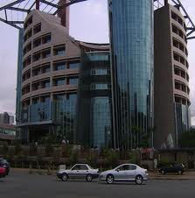
SOCIAL SCIENCES/ADMIN – Career Prospects
Academics
Research institutes ( Economics, Geography etc)
Corporate organizations
Public sector
In actual fact, course of study matters little

Slide 10

HOW TO BECOME A CHARTERED ACCOUNTANT
Route 1
Study accounting in university or polytechnic
Start ICAN Accounting Tehnical Scheme (ATS) right from year 1 in school
Proceed to ICAN 2nd stage (Intermediate) after completing ATS (3 stages)
Route 2
Study accounting
Enrol for ICAN or ACCA immediately after graduation (2 stages)

Slide 11

HOW TO BECOME A CHARTERED ACCOUNTANT (cont’d)
Route 3
Study any course
Enrol for ATS right from year 1
Route 4
Study any course
Enrol for ICAN or ACCA (4 stages) after graduation
Note that ATS/ICAN/ACCA exams are written twice in a year

Slide 12
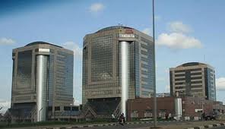

Opportunities for Chartered Accountants
The ‘chartered’ in an accountant makes the difference
You can work almost anywhere
Audit/professional services firm

Slide 13
PARTING SHOT
Whatever you do…never forget your Islam.
“What will miss you will not hit you and what will hit you will not miss you…but strive for what profits you” – Prophet Muhammad (SAW)
THANK YOU

Slide 14
QUESTIONS & ANSWERS

