Slide 1
Climbing the career ladder in corporate Nigeria, The facts, The Myths
I Walk on Water

Slide 2
Agenda
History
What or who is your Anchor
What is your destination
Guaranteed to succeed
Mind your business
Peaks valleys etc

Slide 3
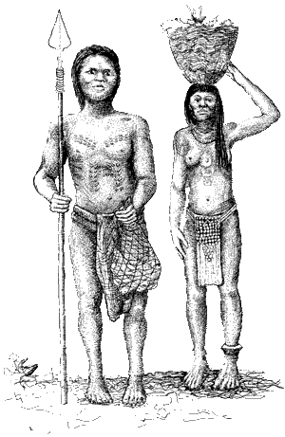
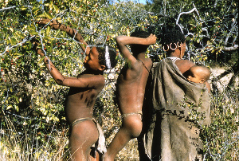

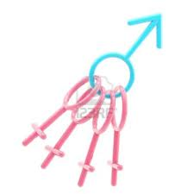
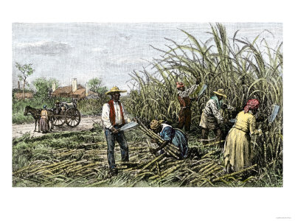
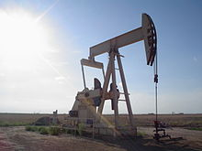
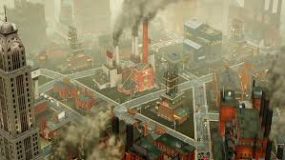
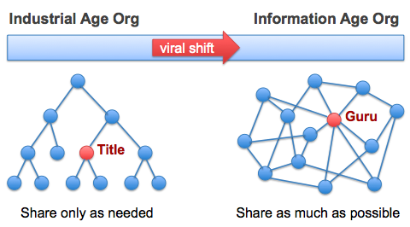
History

Slide 4
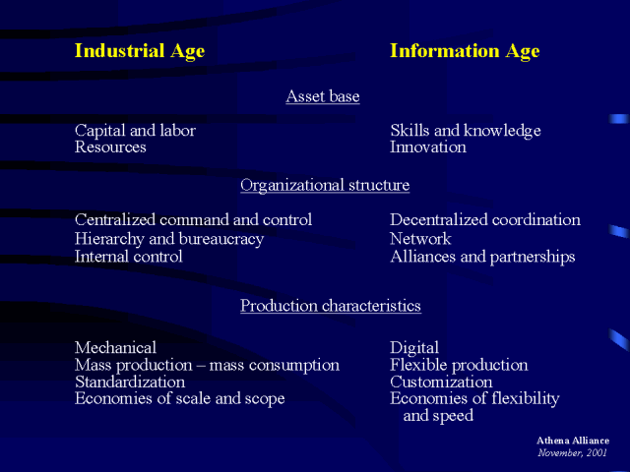
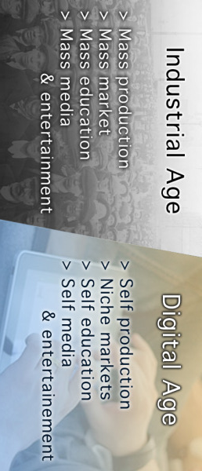
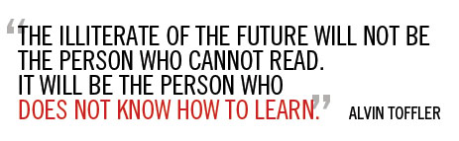
The Age we are in now

Slide 5
What Career?
An occupation undertaken for a significant period of a person’s life and with opportunities for progress.....Oxford Dictionary
In personal development, career development is:
" ... the total constellation of psychological, sociological, educational, physical, economic, and chance factors that combine to influence the nature and significance of work in the total lifespan of any given individual…A Policy Statement of the National Career Development Association Board of Directors (Adopted March 16, 1993; revised 2003
Examples?

Slide 6
What or who is your anchor
Do you have someone or something you hold on to? God? Principles? Self?
Challenge with not having a belief system

Slide 7
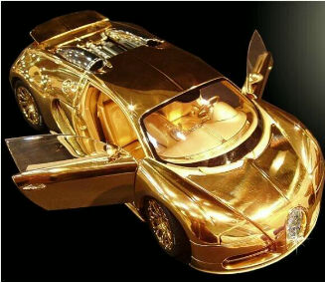
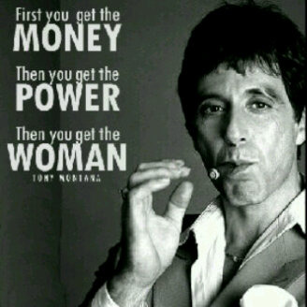

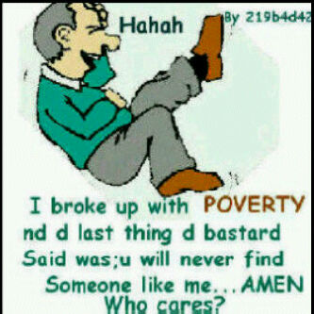
What is your destination

Slide 8
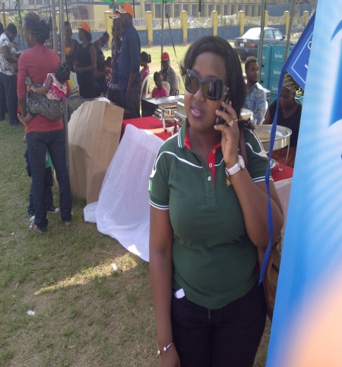
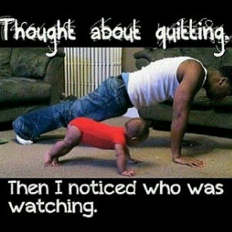
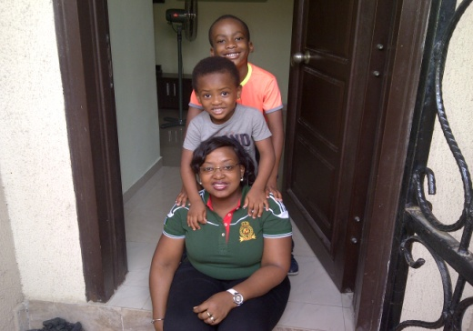

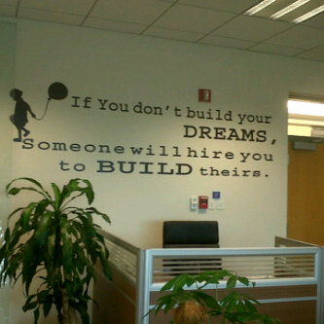

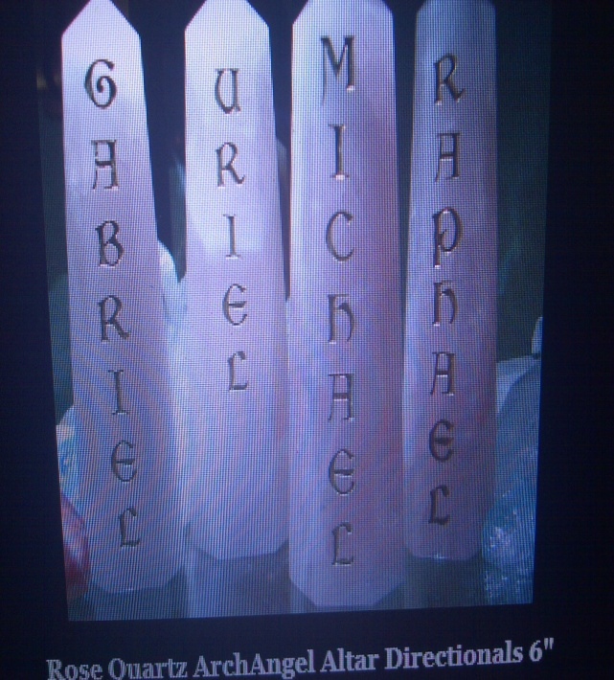
Destination

Slide 9
Guaranteed to succeed
You were created to succeed
You were created to leave a positive legacy for the next generation
You are indestructible
You are manifesting and you will keep doing that so its not about now
Change is inevitable. Remember you must see it as positive

Slide 10
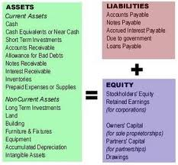
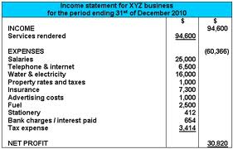
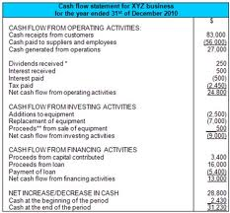
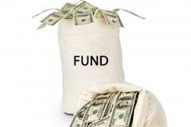
Mind your Business
How to use Debt

Slide 11
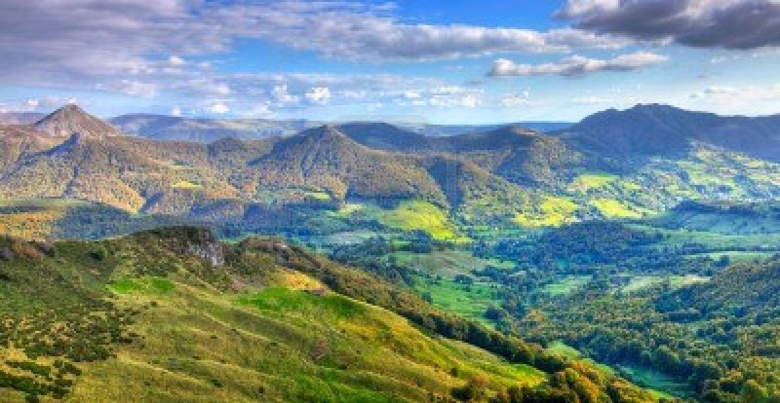
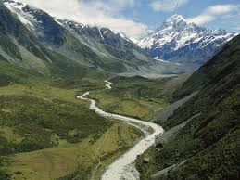
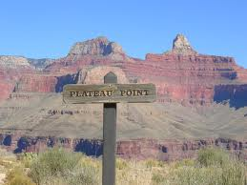
Expect to see this all through your life. It is normal so don’t sweat it

Slide 12
Peaks, Valleys & Plateaus
Know when to be Defensive and Offensive all through
Enables you understand when you draw on your reserves, planning and/or expanding your frontiers while saving.
Peak is when your effort seem to be generating more than expected , Save and invest part (Be humble)
Valleys: You draw on your reserves ( Fear Not)
Plateau: You plan your course of action on how to use your savings to get to the next level (follow your heart, do what you love, do not disregard information available (risk mitigation)

Slide 13
QUESTIONS ?

